Slide 1
TRADE UNION diGITALIZATION OFFICERS FOR EFFECTIVE TRADE UNIONS IN THE NEW DIGITAL WORLD OF WORK
Training in Malaga
6th-8th March 2024
Dominik Owczarek

Slide 2
Training in Malaga – Platform work – 1st day Platform work – key challanges for workers? working conditions union organising and collective bargaining

Slide 3
Training in Malaga – Platform work Research findings in Europe Unions’ strategies to protect platform work National and EU-level policies and unions’ responses

Slide 4
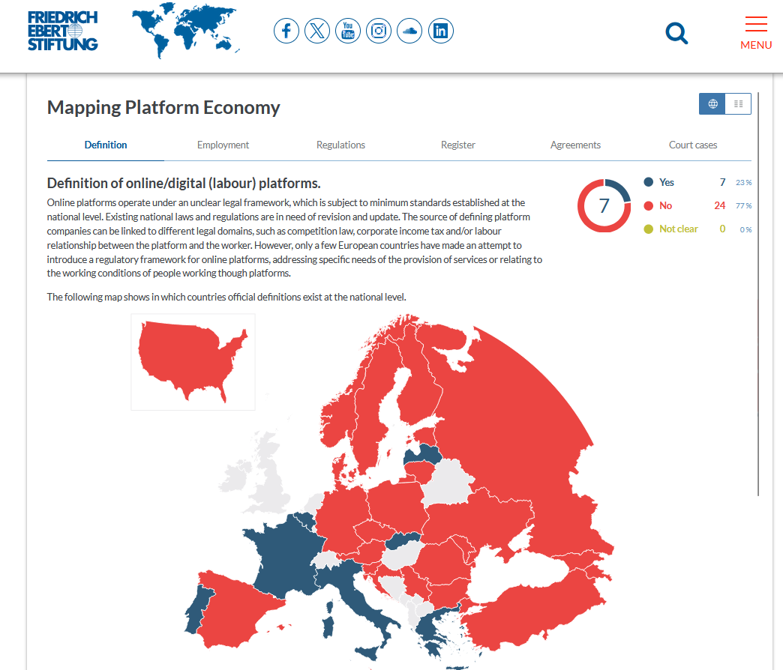
Platform work – Research findings

Slide 5
Platform work – Research findings
Started to emerge in mid 2000s
Business model
Causalisation and informalisation of work
Non-standard forms of employment
Regulative loophole for fraudulent practices

Slide 6
Platform work – Research findings
The scale of employment - platform workers (European Commission)
In 2021, more than 28 million people in the EU work via digital platforms
This number is expected to reach 43 million in 2025
The introduction of regulation in the form of a directive could change the employment status qualification of between 1.72 million and 4.1 million people.

Slide 7
Platform work – Research findings
The scale of employment - platform workers (ETUI, 2022)
47.5 million internet workers, 12 million platform workers and 3 million main platform workers in the EU27 in 2021
17 per cent of the working age population did some internet work in the past year, 4.3 per cent did platform work and 1.1 per cent can be classified as ‘main platform workers’

Slide 8
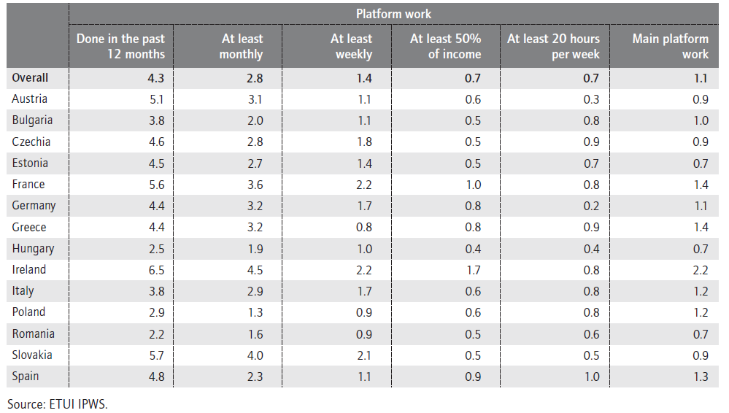
Platform work – Research findings

Slide 9
Platform work – Research findings
The scale of employment - platform workers (ETUI, 2022)
Platform workers tend to be somewhat younger, they are better educated than those who have never done internet work and this is particularly the case for higher skill professional work. Internet work seems mainly to complement offline precarious work and serves as an extra source of income for those on less stable contracts.

Slide 10
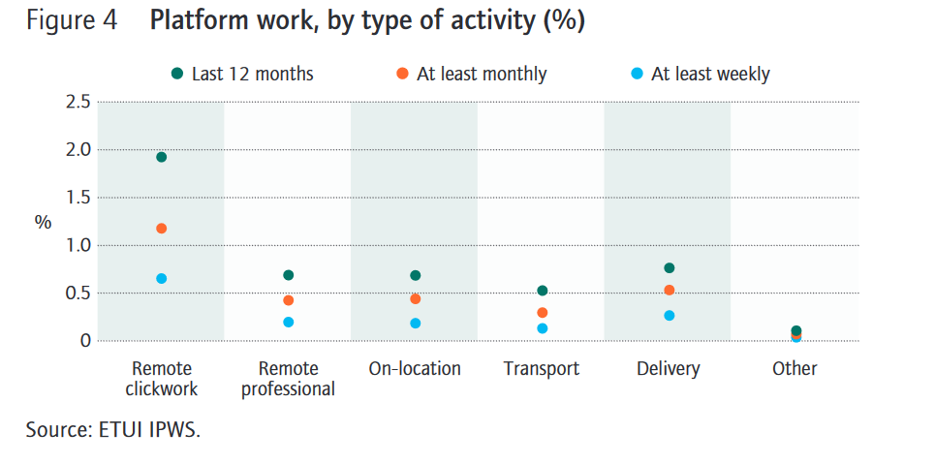
Platform work – Research findings

Slide 11
Platform work – Research findings
The scale of employment - platform workers in Poland (ISP, 2018)
4% platform workers
Younger people / students
Living in large cities
Platform work as a side or casual occupation
Employed under civil law contracts or self-employed

Slide 12
Platform work – Research findings
The scale of employment - platform workers in Poland (ISP, 2018)
Time commitment per week:
31% - difficult to estimate;
25% - less than 10h
25% - 10-20h;
14% - 20-40h;
9% - more than 40h
Earnings:
40% up to 1 thousand PLN / 250 EUR
26% - 1-2 thousand PLN / 250-500 EUR
18% - 2-5 thousand PLN / 500-1250 EUR
9% - above 5 thousand PLN / 1250 EUR

Slide 13
Platform work – Research findings
 | STABILITY | SOCIAL PROTECTION | OSH | WORK-LIFE BALANCE | FLEXIBILITY OF WORKTIME | SKILLS AND CAREER DEVELOPMENT | HIGHER EARNINGS | ACCESS TO UNIONS | INTEGRATION AT WORKPLACE | INDEX | STRESS, intensity and length of work
Telework | 16,7 | 16,1 | 28,8 | 36,3 | 45,3 | 23,9 | 29,5 | 16,2 | 15,9 | 25,4 | 25,9
Job Sharing | 20,6 | 24,1 | 28,0 | 24,8 | 26,8 | 27,1 | 24,5 | 20,0 | 30,2 | 25,1 | 29,3
Causal | 13,9 | 14,5 | 19,0 | 27,7 | 44,4 | 20,3 | 28,0 | 13,8 | 24,8 | 22,9 | 32,1
portfolio | 16,8 | 15,9 | 21,3 | 20,7 | 24,9 | 25,2 | 27,1 | 17,0 | 21,1 | 21,1 | 26,3
Platform work | 18,1 | 16,8 | 20,4 | 24,2 | 30,2 | 25,2 | 24,5 | 16,1 | 17,5 | 21,5 | 24,5
 | 17,2 | 17,5 | 23,5 | 26,7 | 34,3 | 24,4 | 26,7 | 16,6 | 21,9 |  | 27,6

Slide 14
Platform work – Research findings
Employment vs. self-employment / ucp
No regulation specific to platform work
third category of worker between salaried employee and self-employed (platform work as a temporary employment agency (e.g.: Take Task)
platform work as an atypical form of employment. Platform work is treated by platforms as cooperation with independent contractors (independent contractors, B2B) → application of civil law and competition rules

Slide 15
Platform work – Research findings
Responsibility for running the business rests on the shoulders of the platform worker (independent contractor)
Payment of income tax, VAT
Social security, sickness insurance
Health insurance
Personal accident insurance and others
Limitation of workers' rights:
Right to minimum wage / minimum rate
Working time regulations
Right to leave (annual, unpaid, maternity, parental)
Right to collective bargaining, conclusion of collective agreements
Limited trade union rights in practice
Right to labour courts
Employee benefits (e.g. ZFSS, PPK, additional health insurance)(...)

Slide 16
Platform work – Research findings
Practical issues
Negotiating rates (hourly vs. task-based rate)
Method of calculating rates (algorithmisation and lack of transparency)
Payment of rates below 50% of the minimum wage (no obligation to pay income tax and social security (forced labour ?)
Labour exploitation - especially in the case of migrant workers
Illegal practices of intermediaries (undeclared work, non-payment of wages, incorrect calculation of wages, contracts for "car / bicycle / clothes / thermal bag rental")
Compliance with health and safety regulations
Lack of training
Lack of connection of the employee with the job and the employer
Protection of personal data (GDPR)
Limited security (vide London)
Lack of control tools for platform work (labour inspectorates controls)

Slide 17
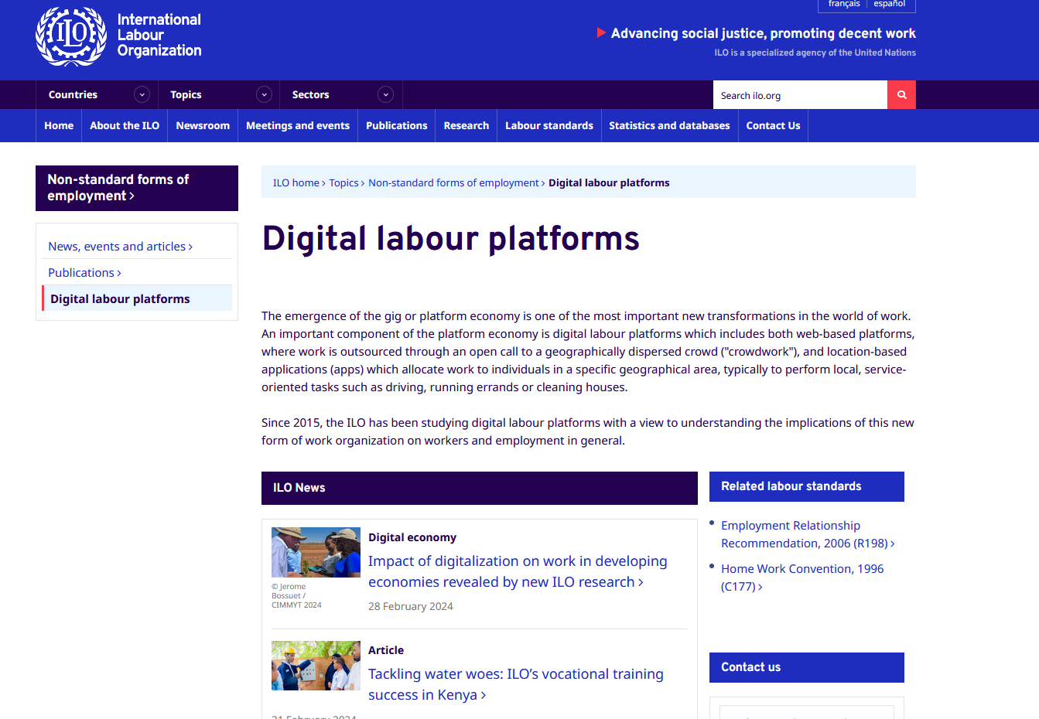
Platform work – Research findings

Slide 18
Unions’ strategies to protect platform work
Challenges: lack of physical workplace, dispersion of workers, flexible working time patterns, causal employment relation, and use of new technologies (both digital devices and online applications).
through social media, thematic forums and dedicated online platforms
leaflets encouraging to join unions and containing information about services dedicated to platform workers.
flash mob in Cologne
Collectif des Livreurs Autonomes Parisiens (CLAP) for delivery workers in France
Union platform for freelancers created by CFDT, supporting them with accounting, civil and professional insurance, complementary health insurance, and legal advice, as well as mutual aid between members.
UILTUCS (Italy) has established a helpdesk to support gig workers with fiscal and legal consultancy services.

Slide 19
Unions’ strategies to protect platform work
Challenges: lack of physical workplace, dispersion of workers, flexible working time patterns, causal employment relation, and use of new technologies (both digital devices and online applications).
http://faircrowd.work/ – an online platform initiated by IG Metall, Austrian Chamber of Labour, Austrian Trade Union Confederation, and Unionen aiming at a workers’ assessment (ranking) of digital platforms based on surveys with workers and exchange of information on workers’ experiences. The portal contains also other useful information, like basic knowledge on platform work, contacts to unions organising gig workers, link to the ‘Frankfurt declaration’;
https://selbststaendigen.info/ – an online platform operated by Ver.di addressed to independent contractors (self-employed, gig workers, etc.) delivering legal, contract-related and tax advice to both union members and other independent contractors. The latter group is charged for the advice while the union members are supported on the basis of their membership fees.

Slide 20
Unions’ strategies to protect platform work
Challenges: lack of physical workplace, dispersion of workers, flexible working time patterns, causal employment relation, and use of new technologies (both digital devices and online applications).
http://www.turespuestasindical.es/ – an online platform operated by UGT to inform and advise platform workers in Spain. The goals of this platform include information, vindication of rights, organisation, and denunciation, as well as serving as a tool to encourage participation in unions;
https://precaritywar.es/ – an online platform operated by CCOO and addressed to atypical workers, aiming at legal assistance for platform delivery workers operating in Madrid;

Slide 21
National and EU-level policies and unions’ responses
Draft Directive on improving working conditions in platform work (10 Dec 2021)
Objectives:
To improve working conditions through online platforms "by ensuring the correct determination of their employment status, promoting transparency, fairness and accountability in the algorithmic management of work through online platforms and improving the transparency of work through online platforms, including in cross-border situations, while supporting the conditions for the sustainable growth of digital labour platforms in the Union.„
Realising the European Union's Treaty value of equality: in access to the labour market and social protection, as well as in the context of the competitiveness of economic operators in the European Union's single market
Eliminating unfair practices, in particular competing with other companies by avoiding the coverage of their workers by minimum standards of social security and a safe and healthy workplace.

Slide 22
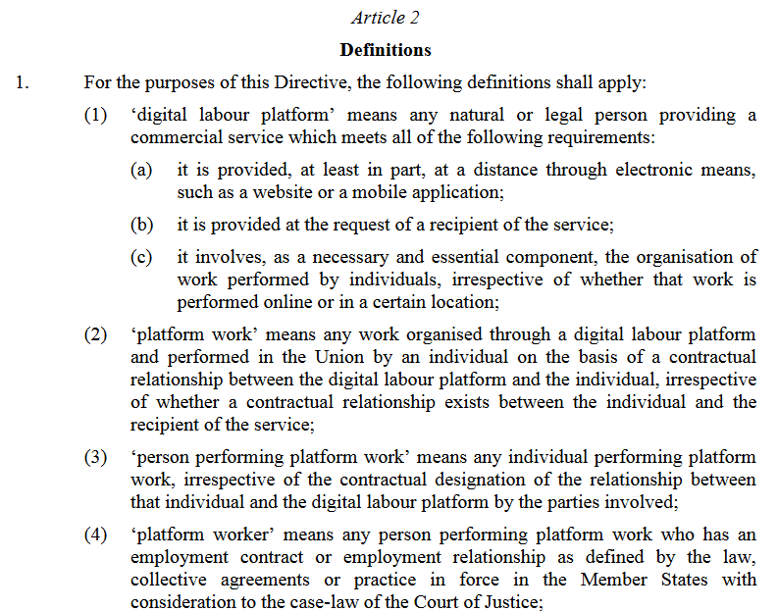
National and EU-level policies and unions’ responses
Draft Directive on improving working conditions in platform work (10 Dec 2021)
Definitions:.

Slide 23
National and EU-level policies and unions’ responses
Draft Directive on improving working conditions in platform work (10 Dec 2021)
Key principles:.
rebuttable presumption on employment status
reversed burden of the proof

Slide 24
National and EU-level policies and unions’ responses
Draft Directive on improving working conditions in platform work (10 Dec 2021)
Controlling the performance of work within the meaning of paragraph 1 shall be understood as fulfilling at least two of the following:
(a) effectively determining, or setting upper limits for the level of remuneration;
(b) requiring the person performing platform work to respect specific binding rules with regard to appearance, conduct towards the recipient of the service or performance of the work;
(c) supervising the performance of work or verifying the quality of the results of the work including by electronic means;
(d) effectively restricting the freedom, including through sanctions, to organise one’s work, in particular the discretion to choose one’s working hours or periods of absence, to accept or to refuse tasks or to use subcontractors or substitutes;
(e) effectively restricting the possibility to build a client base or to perform work for any third party

Slide 25
National and EU-level policies and unions’ responses
Draft Directive on improving working conditions in platform work (10 Dec 2021)
the right to access and challenge the content of the digital platforms algorithm managing the work,
confirmation of the right to information and consultation,
protection of personal data (specific provisions for platform workers),
obligation to comply with health and safety regulations,
obligation to register platforms and provide employment information to national authorities,
the right of workers to communicate with each other through the platform without access by the employer

Slide 26
Training in Malaga Impact of digitalisation on job quality – 2nd day How digitalisation impacts working conditions and modes of union organising in various sectors?

Slide 27
Impact of digitalisation on job quality
Overview of the main opportunities and threats related to digitalisation - Voss and Rego (2019)
Opportunities:
New jobs (computer engineers and scientists, network experts, maintenance etc.)
More ‘agile’ work organisation; new forms of more flexible and more autonomous work
Abolition of repetitive, low-skill and routine tasks, reduction or elimination of arduous or dangerous work. Improvement of occupational safety and health
Better ergonomics, help in performance of heavy or complex tasks

Slide 28
Impact of digitalisation on job quality
Overview of the main opportunities and threats related to digitalisation - Voss and Rego (2019)
Opportunities:
New forms of collaboration and cooperation among workers
Reshoring (return of industries and new ‘smart’ factories – and jobs – to their regions or country of origin)
Possibility of new ways of distributing productivity gains (working time reduction)
Possibilities of social emancipation due to a new concept of ‘work’ and change of economic model based on peer-to-peer relations (where all participants/actors are equal) and common goods

Slide 29
Impact of digitalisation on job quality
Overview of the main opportunities and threats related to digitalisation - Voss and Rego (2019)
Threats:
Destruction of medium and low-skilled jobs (automation and computerisation)
Intensification of ‘anytime, anywhere’ work; ‘always-on culture’; ‘hyper-connectivity’ resulting in blurring of the boundary between private life and working life leading to stress and burnout
Loss of control by workers over their own expertise, know-how and free will (becoming the “tool” of a machine)
Digital management, policing of workers, risk of mutual loss of trust between employees and management
Depersonalization of work, loss of face-to-face interactions, erosion of social skills at work
Precarisation of jobs and of employment relationships, dependence on ‘data masters’; ‘servification’

Slide 30
Impact of digitalisation on job quality
Overview of the main opportunities and threats related to digitalisation - Voss and Rego (2019)
Threats:
Weakening of collective action and industrial relations; shrinking of traditional collective bargaining coverage
Skills and training/labour demand mismatch
Exacerbation of inequalities (as regards skills and competences, “core” vs. “peripheral” jobs and positions, etc.)
Wage level stagnation or decline due to an increase in highly flexible employment relationships and interrupted employment histories
"Digital Taylorism" and emergence of a class of digital workplace-based workers (crowd sourcing); world competition among workers for all jobs not requiring face-to-face contact
Erosion of country-based tax base and social insurance financing

Slide 31
Impact of digitalisation on job quality
Overview of the main opportunities and threats related to digitalisation
The impact of Digitalisation on job Quality and social dialogue in the public services (DIGIQU@LPUB) conducted in the years 2021-2023 in Denmark, Finland, France, Germany, Hungary, Italy, Poland and Spain
Public administration
Healthcare
Electricity sector

Slide 32
Impact of digitalisation on job quality
Overview of the main impact of digitalisation on job quality, DIGIQU@LPUB (2021-2023)
Positive impacts:
greater flexibility in time and space (remote work),
more autonomy at work,
reduction of routine repetitive tasks,
better work-life balance,
improved collaboration,
communication and knowledge sharing with colleagues and users,
the reduction of absenteeism,
physical and mental health outcomes.

Slide 33
Impact of digitalisation on job quality
Overview of the main impact of digitalisation on job quality, DIGIQU@LPUB (2021-2023)
Negative impacts:
physical and mental health outcomes
work intensification,
de-personalisation of service tasks (‘social time’),
individualisation of work relationships with colleagues and managers,
control and monitoring of workers and their job tasks,
blurring of boundaries between work and private life,
physical and mental health hazards

Slide 34
Impact of digitalisation on job quality
Overview of the main impact of digitalisation on job quality, DIGIQU@LPUB (2021-2023)
Paradoxical tensions: workers must cope with these in order to strike a proper a balance.
greater flexibility in time and space vs. respect of effective contractual working hours,
work-life balance vs. hyper-connectivity,
individualised work vs. team work,
enhanced information vs. information overload,
increased autonomy vs. increased control,
upskilling vs. deskilling,
better public services vs. distancing from the users.

Slide 35
Impact of digitalisation on job quality
Overview of the main impact of digitalisation on job quality, DIGIQU@LPUB (2021-2023)
Survey results:
Impact of digitalisation
for roughly one half of the respondents, digitalisation has had a neutral (no change) impact on job quality,
for around one third of workers it has had positive effects,
while for about one fifth of respondents the change has been seen as negative.
Workers from the public hospital and healthcare services stand out from the other public services considered in the project by expressing stronger negative impressions and describing a less positive impact

Slide 36
Impact of digitalisation on job quality
Overview of the main impact of digitalisation on job quality, DIGIQU@LPUB (2021-2023)
Survey results:
Impact of digitalisation
digitalisation is perceived by workers as an additional factor, rather than the cause of fundamental changes in the quality and organisation of work in the public services.
Technical advances allowed by digitalisation exacerbate trends towards reorganisation, flexibilisation and individualisation of work which were already affecting EU public services. These trends are the outcome of the packages of reforms implemented as part of the process of privatising public services, the overwhelming application of the ‘New Public Management’ organisational paradigm in a context of constrained austerity of public expenses, including limitations of public workforce size.

Slide 37
Training in Malaga – 2nd day Information, consultation and participation rights

Slide 38
Information, consultation and participation rights
Country specific regulations
Information, consultation and participation rights:
Works councils Directive 2002/14/WE
Directive 94/45/EC → Directive 2009/38/EC → recast - European Works’ Council
Board-level employee representation (country specific regulations)
Cross-Border Mergers Directive 2005/56/EC and Directive 2019/2121 amending Directive (EU) 2017/1132 as regards cross-border conversions, mergers and divisions

Slide 39
EU legal acts on information and consultation (and related issues)
Council Directive 94/45/EC of 22 September 1994 on the establishment of a European Works Council or a procedure in Community-scale undertakings and Community-scale groups of undertakings for the purposes of informing and consulting employees https://eur-lex.europa.eu/eli/dir/1994/45/oj
Council Directive 2001/86/EC of 8 October 2001 supplementing the Statute for a European company with regard to the involvement of employees https://eur-lex.europa.eu/legal-content/EN/TXT/?uri=celex%3A32001L0086
Directive 2002/14/EC of the European Parliament and of the Council of 11 March 2002 establishing a general framework for informing and consulting employees in the European Community - Joint declaration of the European Parliament, the Council and the Commission on employee representation https://eur-lex.europa.eu/legal-content/EN/ALL/?uri=celex%3A32002L0014
Directive 2005/56/EC of the European Parliament and of the Council of 26 October 2005 on cross-border mergers of limited liability companies https://eur-lex.europa.eu/legal-content/EN/TXT/?uri=celex:32005L0056

Slide 40
EU legal acts on information and consultation (and related issues)
Directive 2009/38/EC of the European Parliament and of the Council of 6 May 2009 on the establishment of a European Works Council or a procedure in Community-scale undertakings and Community-scale groups of undertakings for the purposes of informing and consulting employees (Recast) https://eur-lex.europa.eu/eli/dir/2009/38/oj
Directive (EU) 2017/1132 of the European Parliament and of the Council of 14 June 2017 relating to certain aspects of company law https://eur-lex.europa.eu/legal-content/EN/ALL/?uri=celex%3A32017L1132
Directive (EU) 2019/2121 of the European Parliament and of the Council of 27 November 2019 amending Directive (EU) 2017/1132 as regards cross-border conversions, mergers and divisions https://eur-lex.europa.eu/legal-content/EN/TXT/?uri=CELEX%3A32019L2121

Slide 41
Training in Malaga – 2nd day Key competences for TUDO

Slide 42
Key competences for TUDO
Thematic knowledge on various aspects of digitalisation, including potential gains and challenges for workers
Knowledge on collective representation mechanisms (both legal regulations and practices)
Union organising and networking skills

Slide 43
Key competences for TUDO
Thematic knowledge on various aspects of digitalisation, including potential gains and challenges for workers.
The above parts of the manual aimed at shedding a light on some selected aspects of digitalisation and challenges for the workers. The TUDO trainings will develop further these aspects and will allow for discussion and exchange of experiences of the officers from various countries.
This will allow TUDOs to conduct their work aiming at counteracting
possible increase of inequalities among workers,
deterioration of working conditions and
mitigating possible negative impact of digitalisation on the workers’ rights

Slide 44
Key competences for TUDO
Knowledge on collective representation mechanisms (both legal regulations and practices)
In order to act effectively, the TUDOs need to have broad knowledge and understanding of workers’ rights and collective relations. Despite the fact that the training provided will focus specifically on various aspects of digitalisation, some selected elements on collective labour relations will be provided to the participants, e.g. legal regulations on information, consultation and participation rights (mostly at the EU level), European policies and initiatives (e.g. Charter of Fundamental Rights of the European Union, European Pillar of Social Rights, recent developments on platform work directive, telework and right to disconnect directive, recast directive on European works councils, reform of European social dialogue, etc.).
It is recommended that TUDO will develop their knowledge individually on country level regulations and practices related to trade unions, collective labour disputes, industrial relations systems, including collective bargaining, etc.)

Slide 45
Key competences for TUDO
Union organising and networking skills
The tasks for TUDO is to provide support in their own country in order to prepare union members to negotiate various aspects of digitalisation at company and sectoral level, and to update their knowledge by exchange in the international network.
Therefore, effective transnational cooperation, communication and negotiation skills, as well as the use of digital communication tools in the work of TUDO will be of key importance.

Slide 46
THANK YOU
For further information:
Dominik Owczarek
domink.owczarek@gmail.com

