Slide 1
TRADE UNION diGITALIZATION OFFICERS FOR EFFECTIVE TRADE UNIONS IN THE NEW DIGITAL WORLD OF WORK
Online training
27th Feb 2024
Dominik Owczarek

Slide 2
2nd online training Telework – key challanges for workers ?

Slide 3
2nd online training EU-level policies on telework and the right to disconnect Telework and teleworkability in the EU – empirical findings Case studies - benefits and challanges of telework

Slide 4
EU-level policies on telework and the right to disconnect
EU-level social partners Framework Agreement on Telework (2002)
- national-level regulations
European Social Partners Framework Agreement on Digitalisation (June 2020)
European Parliament resolution with recommendations to the Commission on the right to disconnect (Jan 2021)
Draft bill for the Directive on telework and the right to disconnect failed in Dec 2023

Slide 5
EU-level policies on telework and the right to disconnect
EU Working Time Directive (Directive 2003/88) includes provisions aimed at protecting the safety and health of workers (maximum of 48 working hours per week, etc.), including those performing telework;
Framework Directive on Safety and Health at Work (Council Directive 89/391/EEC) when dealing with the health and safety of workers in the workplace, does not specify the work location and, accordingly, also applies to remote workers;
Transparent and Predictable Working Conditions Directive (Directive (EU) 2019/1152) indirectly affects remote workers as it requires that provisions be made in relation to the place of work and that work patterns be clarified in the employment contract. Moreover, the directive seeks to protect workers from on-demand requests and this could help to reduce the unpredictability of irregular working time patterns and have a positive impact on the work–life balance of workers; although it does not deal with the potentially negative impact of telework,

Slide 6
EU-level policies on telework and the right to disconnect
the Work-Life Balance Directive (Directive (EU) 2019/1158), includes telework as one of the flexible working arrangements to which working parents and carers are entitled. Remote workers who exercise this right are protected against discrimination or any unfavourable treatment resulting from the request;
General Data Protection Regulation (Regulation (EU) 2016/679), replacing Directive 95/46/EC, regulates the collection, use and transfer of personal data, and establishes provisions related to data-processing operations, including employee monitoring. In this view, this regulation requires that employees’ consent be given prior to the introduction of any employee monitoring system.

Slide 7
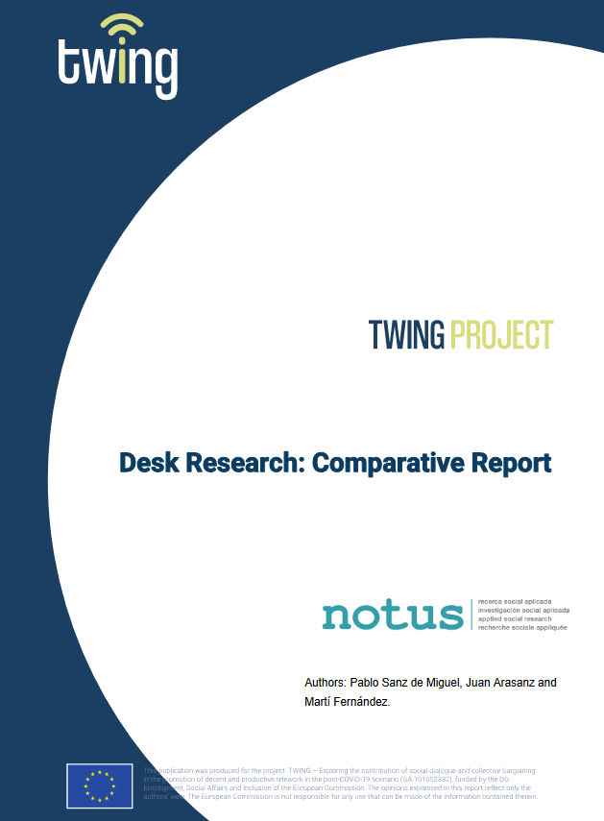
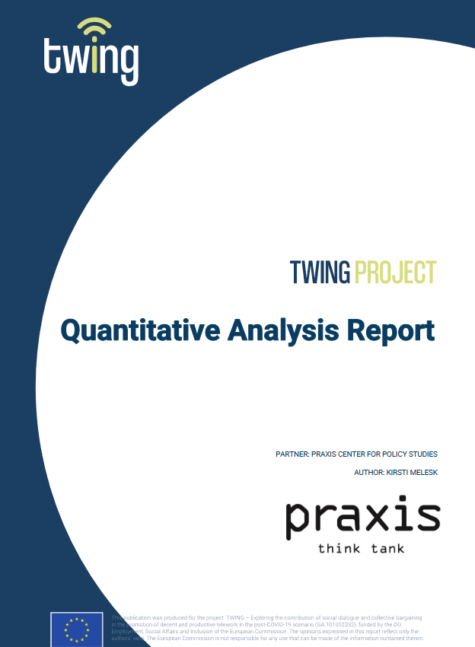
Telework and teleworkability in the EU – empirical findings

Slide 8
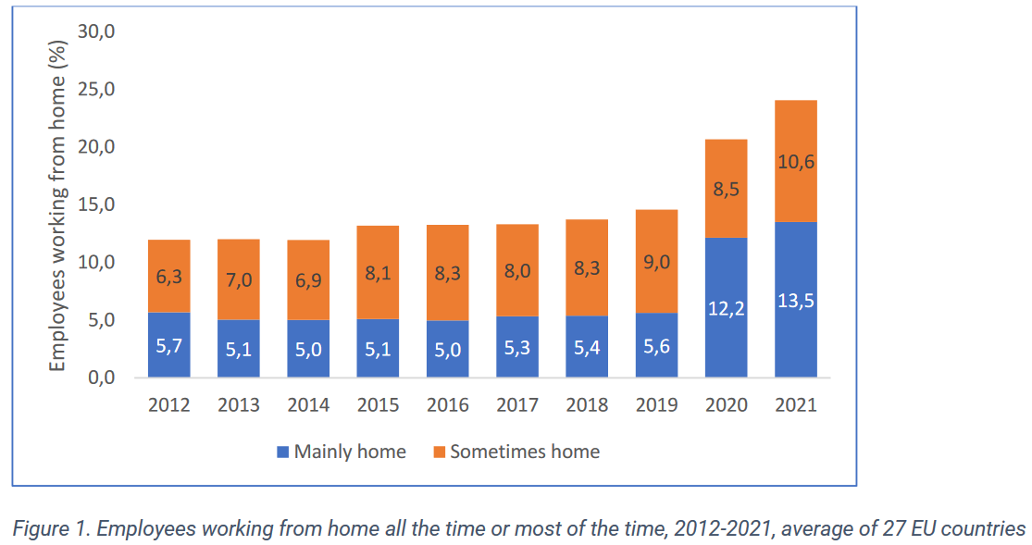
Telework and teleworkability in the EU – empirical findings

Slide 9
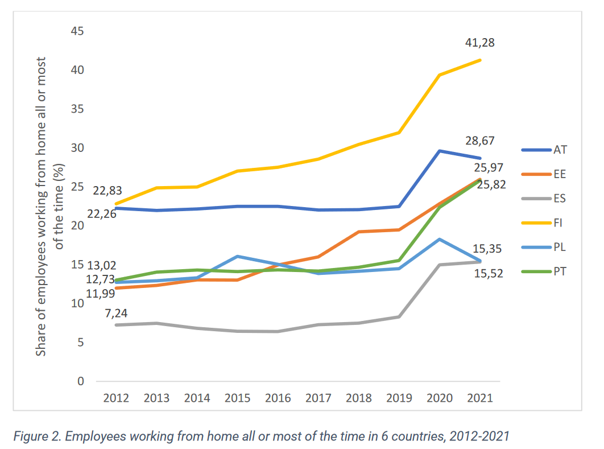
Telework and teleworkability in the EU – empirical findings

Slide 10
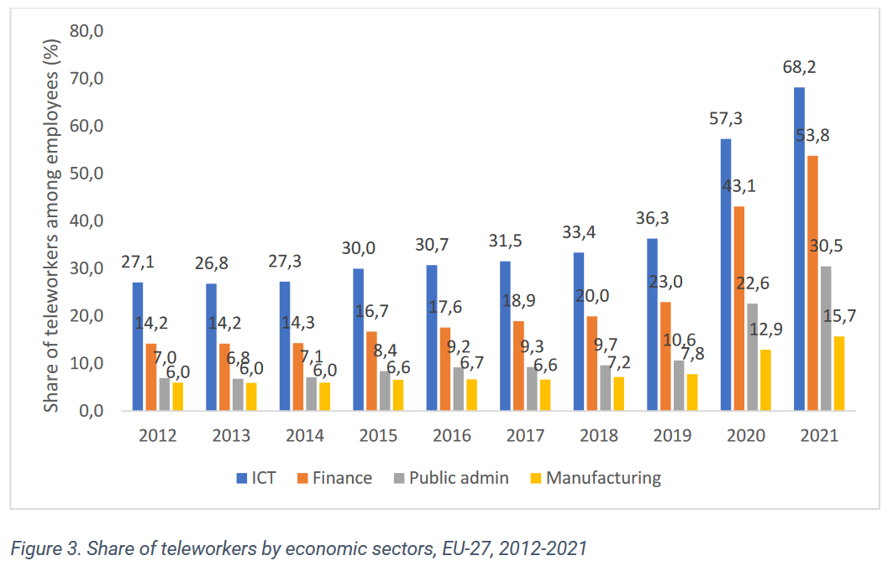
Telework and teleworkability in the EU – empirical findings

Slide 11
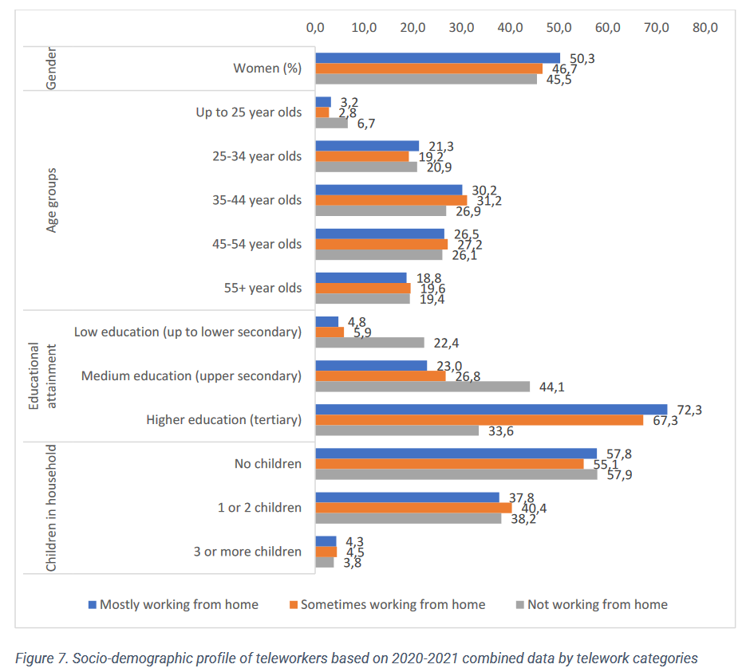

Slide 12
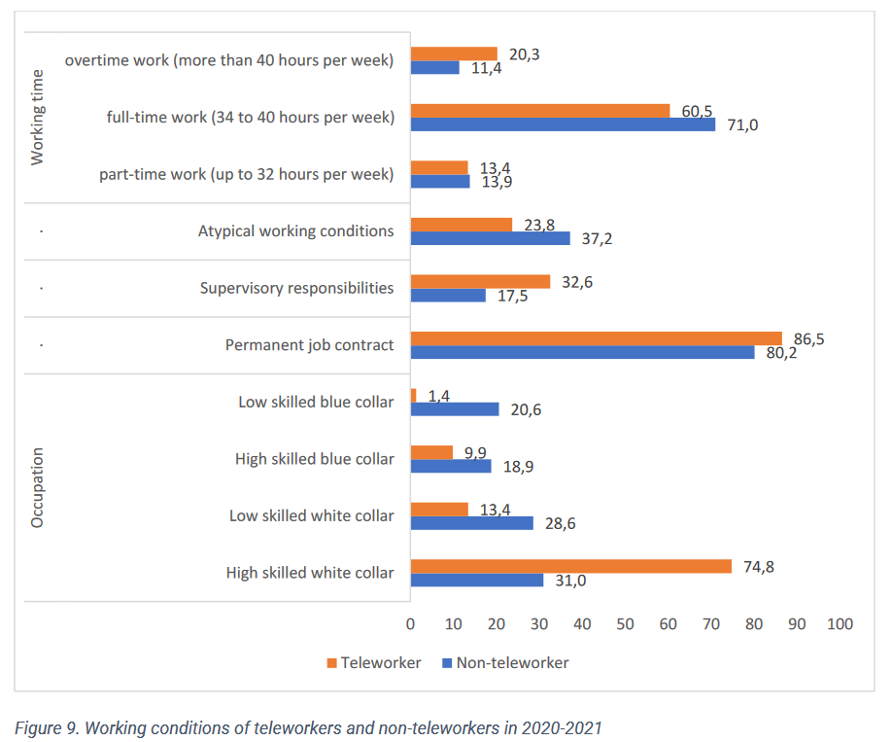

Slide 13
Telework and teleworkability in the EU – empirical findings
Share of potentially teleworkable employment in the European Union (EU) is approximately 37% (Eurofound, 2021), varying from 27% in Romania to 54% in Luxembourg.
Teleworkable employment is more prevalent among women (45%) compared to men (30%),
More common among native-born workers, those with open-ended contracts, and individuals working in large companies and urban areas, as opposed to suburban or rural regions.
Teleworkable employment is significantly large among white-collar workers than blue-collar workers, the latter characterized by physical requirements and location dependence. Among white-collar workers, the potential teleworkable employment ranges from 85% for clerical support workers to approximately 28% for service and sales workers, while the share is less than 2% among blue-collar workers such as craft and trade workers, machine operators, and elementary occupations.

Slide 14
Telework and teleworkability in the EU – empirical findings
Service sectors with a higher prevalence of white-collar employees, such as financial services (93%) and ICT services (79%), have higher proportions of teleworkable employment. Sectors like healthcare (30%), retail (27%), and accommodation/food services (16%) have lower shares of teleworkable employment. Primary sectors, manufacturing, and construction have relatively low proportions of teleworkable employment, ranging from 10% to 20%. Wage and education levels play crucial roles as determinants of teleworkability. Higher-paying jobs and greater educational attainment are associated with larger shares of potential teleworkable employment, with 74% of the highest-paying jobs falling into this category compared to only 3% of the lowest-paying jobs.

Slide 15
Case studies - benefits and challanges of telework

Slide 16
Case studies - benefits and challanges of telework
 | Company profile | Sector | Sort of out-of-office work | White / blue collars | Presence of trade unions | Collective agreement
France | insurance and manufacturing of automotive equipment | Private | Working from home | White / blue collars | No, works council present | No
 | universal bank with global outreach | Private | Working from home | White collars | yes | yes
Italy | regional administration | Public | Working from home | White collars | yes | yes
 | electricity company | private/ public | ICT-based mobile work | Blue collars | yes | yes
Poland | universal bank with global outreach | Private | Working from home | White collars | yes | no
 | electricity company | Public / private | ICT-based mobile work | Blue collars | yes | yes
Romania | IT company | Private | Working from home | White collars | no | no
 | university | Public | Working from home | White collars | yes | yes
Spain | charter primary public school | Public / private | Working from home | White collars | yes | no
 | telecommunication services provider | Private | Working from home | White collars | yes | yes

Slide 17
Key results – motivation for telework
Modernisation process and adaptation to current market trends (electricity company in Poland and in Italy)
Strategy to address workers’ preferences to improve working conditions (bank and incurance company in France, Regional Administration in Italy, IT company in Romania, telecommunication company in Spain)
Temporary arrangement during the lockdowns imposed by national regulations during the COVID-19 pandemic in order to sustain business activity (bank in Poland, primary school in Spain, university in Romania)

Slide 18
Key results – impact on working conditions
Commuting
Work flexibility:
Flexible tasks arrangements
Flexible workplaces
Autonomy at work (including strengthening self-discipline)
Challenge for young and new workers in companies, difficulties with peer-learning and company identification
Content of work
being able to focus on elements of work that require more commitment or creativity,
tasks requiring teamwork, meetings, peers consultations, or tasks that could be performed only from office (i.e. administrative issues)
limited or deferred feedback from co-workers

Slide 19
Key results – impact on working conditions
Work organisation
workers’ oversight challenge / trust to employees
more online meetings
Health and safety (including psychosocial risks)
physical difficulties due to sedentary work (musculoskeletal disorders, headaches, sight difficulties)
psychological risks: depression
less socializing
Work-life balance (paradox)
better reconciling work and family life (ie. care obligations) vs. blurring boundaries of working time and rest (necessity of the right to disconnect and better self-management)
working from home during the COVID-19 pandemic – workers with children reported lower levels of job satisfaction (gender inequalities), distraction and lower productivity
home-made food vs. excessive eating leading to overweight or obesity

Slide 20
Key results – impact on working conditions
No impact of out-of-office work on the following:
Wages, although media costs reimbursement
Working time, although arrangement of tasks and work breaks and no commuting
Job stability and job security
Social protection
Form of employment / form of contract

Slide 21
Key results – social dialogue
(…)
 | Company profile | Sector | Sort of out-of-office work | White / blue collars | Presence of trade unions | Collective agreement
France | insurance and manufacturing of automotive equipment | Private | Working from home | White / blue collars | No, works council present | No
 | universal bank with global outreach | Private | Working from home | White collars | yes | yes
Italy | regional administration | Public | Working from home | White collars | yes | yes
 | electricity company | private/ public | ICT-based mobile work | Blue collars | yes | yes
Poland | universal bank with global outreach | Private | Working from home | White collars | yes | no
 | electricity company | Public / private | ICT-based mobile work | Blue collars | yes | yes
Romania | IT company | Private | Working from home | White collars | no | no
 | university | Public | Working from home | White collars | yes | yes
Spain | charter primary public school | Public / private | Working from home | White collars | yes | no
 | telecommunication services provider | Private | Working from home | White collars | yes | yes

Slide 22
Key results – social dialogue
Regional Administration in Italy
Developed regulatory framework at national level (Law no. 81/2017 on agile work) and sectoral level (Law 191/1998 and Decree of President of Republic n.70/1999, article 14 of Law no. 124/2015 so-called Madia Reform of the Public Administration )
Definition of telework in cross-industry agreement for the private sector signed on 9 June 2004
Organisational Plan of Agile Work (Pola, 2021-2023) and agreement regulating smart work in the wake of the first renewals of the National collective agreement in the Public Administration
Bank in France (with global outreach)
HR strategies: Road map “Smart working”, “People Care”, 80 "digital working" ambassadors
Collective agreement (with CFDT, CFE CGC and CFTC) 8 July 2021, starting from February 2022 (standardisation of practices in terms of telework, skills, fostering intra-group professional mobility, non-doscrimination and fair treatment)

Slide 23
Key results – social dialogue
School in Spain
National level regulations (temporary COVID-19 related regulations)
No collective agreement present
Bank in Poland (national branch of a global company)
Recent regulations at national level (April 2023) that obliged employers and unions to conclude an agreement on remote work
Some top-down attempts to implement „flexiwork” model in the company as a result of the COVID-19 pandemic
No collective agreement present

Slide 24
Key results – social dialogue
IT company in Romania
National level regulations (Labor Code, CHAPTER 9 - Work at home, articles 108 (Legal definition and special characters), 109 (Home work contract) and 110 (Equality of treatment), Law no 55/2020 –temporary pandemic related regulation)
No collective agreement present

Slide 25
Key results – social dialogue
Conclusions:
Social dialogue at company plays a role, but its impact on out-of-office work vary across cases and countries
The patterns reflect structure of Industrial relations system in Europe
Social dialogue and social partners are more likely to play a greater role in Western European countries than in Central and Eastern Europe
and in larger private and public sector organisations than in small and medium-sized organisations.

Slide 26
Action plan and priorities for the next months of TUDOs work (national and international activities) Manual for TUDOs Trainings: 1st online training session: 21.02.2024 2nd online training session: 27.02.2024 Training in Malaga (Spain): 6-7.03.2024 3 online networking meeting of TUDO network

Slide 27
Information, consultation and participation rights
Country specific regulations
Information, consultation and participation rights:
Works councils Directive 2002/14/WE
Directive 94/45/EC → Directive 2009/38/EC → recast - European Works’ Council
Board-level employee representation (country specific regulations)
Cross-Border Mergers Directive 2005/56/EC and Directive 2019/2121 amending Directive (EU) 2017/1132 as regards cross-border conversions, mergers and divisions

Slide 28
EU legal acts on information and consultation (and related issues)
Council Directive 94/45/EC of 22 September 1994 on the establishment of a European Works Council or a procedure in Community-scale undertakings and Community-scale groups of undertakings for the purposes of informing and consulting employees https://eur-lex.europa.eu/eli/dir/1994/45/oj
Council Directive 2001/86/EC of 8 October 2001 supplementing the Statute for a European company with regard to the involvement of employees https://eur-lex.europa.eu/legal-content/EN/TXT/?uri=celex%3A32001L0086
Directive 2002/14/EC of the European Parliament and of the Council of 11 March 2002 establishing a general framework for informing and consulting employees in the European Community - Joint declaration of the European Parliament, the Council and the Commission on employee representation https://eur-lex.europa.eu/legal-content/EN/ALL/?uri=celex%3A32002L0014
Directive 2005/56/EC of the European Parliament and of the Council of 26 October 2005 on cross-border mergers of limited liability companies https://eur-lex.europa.eu/legal-content/EN/TXT/?uri=celex:32005L0056

Slide 29
EU legal acts on information and consultation (and related issues)
Directive 2009/38/EC of the European Parliament and of the Council of 6 May 2009 on the establishment of a European Works Council or a procedure in Community-scale undertakings and Community-scale groups of undertakings for the purposes of informing and consulting employees (Recast) https://eur-lex.europa.eu/eli/dir/2009/38/oj
Directive (EU) 2017/1132 of the European Parliament and of the Council of 14 June 2017 relating to certain aspects of company law https://eur-lex.europa.eu/legal-content/EN/ALL/?uri=celex%3A32017L1132
Directive (EU) 2019/2121 of the European Parliament and of the Council of 27 November 2019 amending Directive (EU) 2017/1132 as regards cross-border conversions, mergers and divisions https://eur-lex.europa.eu/legal-content/EN/TXT/?uri=CELEX%3A32019L2121

Slide 30
THANK YOU
For further information:
Dominik Owczarek
domink.owczarek@gmail.com

