Slide 1
TRADE UNION diGITALIZATION OFFICERS FOR EFFECTIVE TRADE UNIONS IN THE NEW DIGITAL WORLD OF WORK
Online training
21st Feb 2024
Dominik Owczarek

Slide 2
DURATION: 1 SEPTEMBER 2023 – 30 APRIL 2025
CREATION OF TUDO NETWORK
Exchange of good practices and experiences
INFORMATIVE SEMINARS
E-LEARNING tool
Dissemination articleS
Boosted posts and paid-for social media ads

Slide 3
Project countries Hungary, Italy, Malta, Poland, Romania, Serbia, Slovenia, Spain, Turkey (9) EU-level partners: ETUC, Eurocadres

Slide 4
WORK PACKAGES WP1 – Project management and coordination; WP2 – Project disemination; WP3. Creation of TUDO network; WP4. Capacity building

Slide 5
WP3 – Creation of TUDO network (01.11.2023-30.04.2025)
Responsible Partner: GWU
Objectives:
The knowledge on the EU law and Framework Agreement on digitalization spread across in EU countries and the Candidate Countries;
Best practices and recommendations developed and exchanged, enhanced awareness of information, consultation and participation rights to address the challenges of digital transition and COVID-19 repercussions (e.g. remote jobs, platform work, emergence of new forms of work) through creation of the networking forum for social partners: Trade Union Digitalization Officers network from participating countries;
More effective implementation of the European Social Partners Framework Agreement on Digitalization in EU Member States and dissemination of the Agreement to the candidate countries, resulting in mitigation of the negative employment, social and economic consequences of the Covid-19 crisis and acceleration of digital transition through achievement of more socially responsible manner of digital transition of the European economy, including the reconciliation of work and family life.

Slide 6
Deliverables:
Manual presenting TUDO training content – OPZZ (4 month);
2 online and 1 face-to-face training session organised within a framework of TUDO training course – GWU (6 month);
1st online training session: 21.02.2024
2nd online training session: 27.02.2024
Training in Malaga (Spain): 6-8.-3.2024
3 online networking meetings of TUDO network – CATUS (19 month).

Slide 7
1st online training digitalisation ?

Slide 8
1st online training EU-level policies on digitalisation European Social Partners Framework Agreement on Digitalisation Implementation of ESPFAD – national level (recommendations) – discussion Recommendations on digitalisation for the EU-level social dialogue from TUDOs - discussion

Slide 9
EU-level policies on digitalisation
European Digital Strategy 2020–2025 (Feb 2020)
New generation of technologies, helping to support the ‘just transition’ to a climate-neutral Europe via the European Green Deal.
Digital Services Act package (Dec 2020)
the Digital Services Act (DSA) and the Digital Markets Act (DMA)
Directive on platform work (Dec 2021)
Europe’s digital decade (March 2021 – till 2030)

Slide 10
National-level policies on digitalisation
?

Slide 11
National-level policies on digitalisation
Role of the social partners in creation, consultation, implementation of the national-level policies?

Slide 12
European Social Partners Framework Agreement on Digitalisation
This framework agreement aims to:
Raise awareness and improve understanding of employers, workers and their representatives of the opportunities and challenges in the world of work resulting from the digital transformation;
Provide an action-oriented framework to encourage, guide and assist employers, workers and their representatives in devising measures and actions aimed at reaping these opportunities and dealing with the challenges, whilst taking into account existing initiatives, practices and collective agreements;
 Encourage a partnership approach between employers, workers and their representatives;
 Support development of a human-oriented approach to integration of digital technology in the world of work, to support/assist workers and enhance productivity

Slide 13
European Social Partners Framework Agreement on Digitalisation
June 2020
Emplyers side: BusinessEurope, SMEunited, CEEP
Workers’ side: European Trade Union Confederation (and the liaison committee EUROCADRES/ CEC)
Applies to the whole of the EU/EEA in the public and private sectors, all economic activities including in activities using online platforms where an employment relationship exists, as defined nationally.
Goal:
to achieve a consensual transition by a successful integration of digital technologies at the workplace and by reaping the opportunities as well as preventing and minimising the risks for both workers and employers and to ensure the best possible outcome for both employers and workers.

Slide 14
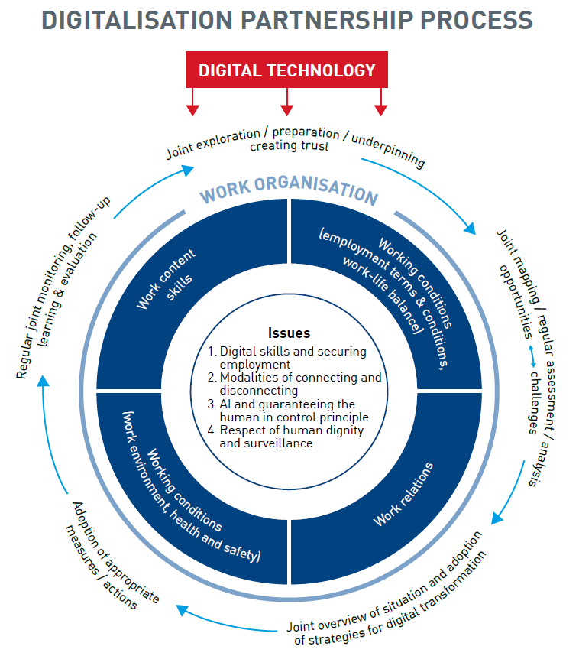
European Social Partners Framework Agreement on Digitalisation

Slide 15
European Social Partners Framework Agreement on Digitalisation
Digital Skills and Securing Employment
Objective: The main objective is to prepare our current and future workforce and enterprises with the appropriate skills by continuous learning, to reap the opportunities and deal with the challenges of the digital transformation in the world of work

Slide 16
European Social Partners Framework Agreement on Digitalisation
Digital Skills and Securing Employment
Measures to be considered include:
The commitment of both parties to upskill or reskill to meet the digital challenges of the enterprise.
Access to and arrangements of training, in line with diverse national industrial relations and training practices and taking into account the diversity of the workforce, such as in the forms of training funds / sectoral funds, learning accounts, competence development plans, vouchers. Training provisions should spell out clearly the conditions of participation, including in terms of duration, financial aspects, and worker commitment.
Where an employer requests to a worker to participate in a job-related training that is directly linked to the digital transformation of the enterprise, the training is paid by the employer or in line with the collective agreement or national practice. This training can be in-house or offsite and takes place at an appropriate and agreed time for both the employer and the worker, and where possible during working hours. If the training takes place outside of working time, appropriate compensation should be arranged.
A focus on quality and effective training: This means to provide access to relevant training responding to the identified training needs of the employer and the worker. A key aspect of this in the context of the digital transformation is to train workers, to help them make the best possible use of the digital technologies that are introduced.

Slide 17
European Social Partners Framework Agreement on Digitalisation
Digital Skills and Securing Employment
Measures to be considered include:
Training arrangements that provide skills which could support mobility between and
within sectors.
Internal or external training validation solutions.
The operation of schemes such as short time work that combines a reduction of working hours with training, in well-defined circumstances.

Slide 18
European Social Partners Framework Agreement on Digitalisation
Digital Skills and Securing Employment
Digitalisation strategies are built on a shared commitment of social partners to:
Retraining and upskilling, so that workers can transfer to new jobs or adapt to
redesigned jobs within the enterprise, in agreed conditions;
The redesign of jobs to allow workers to remain within the enterprise in a new role if some of their tasks or their job disappears due to digital technology;
The redesign of work organisation if necessary, to take account of changed tasks, roles or competences;
An equal opportunities policy to ensure that digital technology results in benefit for all workers.
If digital technology contributes to inequality for example between women and men, this issue must be addressed by the social partners.

Slide 19
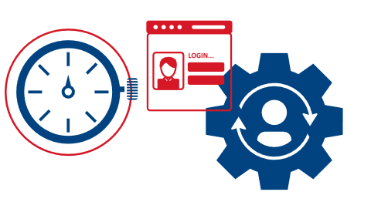
European Social Partners Framework Agreement on Digitalisation
Modalities of connecting and disconnecting
The presence and/or introduction of digital devices/tools in workplaces can
provide many new opportunities and possibilities to organise work in a flexible way to the benefit of employers and workers.
At the same time, this may create risks and challenges around the delineation of work and of personal time both during and beyond working time.
It is the employer’s duty to ensure the safety and health of workers in every aspect related to the work. To avoid possible negative effects on workers.’ health and safety and on the functioning of the enterprise, the focus should be on prevention.
This refers to a culture where employers and workers actively participate in securing a safe and healthy working environment through a system of defined rights, responsibilities and duties, and where the principle of prevention is accorded the highest priority.

Slide 20
European Social Partners Framework Agreement on Digitalisation
Modalities of connecting and disconnecting
Measures to be considered include:
Training and awareness raising measures;
Respect of working time rules and teleworking and mobile work rules;
Appropriate measures to ensure compliance;
Providing guidance and information for employers and workers on how to respect working time rules and teleworking and mobile work rules including on how to use digital tools, e.g. emails, including the risks of being overly connected particularly for health and safety;
Being clear about the policies and/or the agreed rules on the use of digital tools for private purposes during working time;
Commitment from management to create a culture that avoids out of hours contact;

Slide 21
European Social Partners Framework Agreement on Digitalisation
Modalities of connecting and disconnecting
Measures to be considered include:
Work organisation and workload, including the number of staff, are key aspects which need to be identified and evaluated jointly;
Achievement of organisational objectives should not require out of hours connection. With full respect for working time legislation and working time provisions in collective agreements and contractual arrangements, for any additional out of hours contacting of workers by employers, the worker is not obliged to be contactable;
And in respect of the bullet point above, appropriate compensation for any extra time worked, and;
Alert and support procedures in a no-blame culture to find solutions and to guard against detriment for workers for not being contactable;
Regular exchanges between managers and workers and/or their representatives on the workload and work processes; Alert and support procedures;
Prevention of isolation at work.

Slide 22
European Social Partners Framework Agreement on Digitalisation
Artificial intelligence (AI) and Guaranteeing Human in control principle
The control of humans over machines and artificial intelligence should be guaranteed in the workplace and should underpin the use of robotics and artificial intelligence applications whilst respecting and complying with safety and security controls.
Trustworthy AI has three components, which should be met throughout the system’s entire life cycle and must be respected in the deployment in the world of work:
it should be lawful, fair, transparent, safe, and secure, complying with all applicable laws and regulations as well as fundamental rights and non-discrimination rules,
it should follow agreed ethical standards, ensuring adherence to EU Fundamental/human rights, equality and other ethical principles and,
it should be robust and sustainable, both from a technical and social perspective since, even with good intentions, AI systems can cause unintentional harm.
The potential tensions between respect for human autonomy, prevention of harm, fairness and explicability of decision making should be acknowledged and addressed.

Slide 23
European Social Partners Framework Agreement on Digitalisation
Artificial intelligence (AI) and Guaranteeing Human in control principle
Measures to be considered include:
Deployment of AI systems:
should follow the human in control principle;
should be safe, i.e. it should prevent harm. A risk assessment, including opportunities to improve safety and prevent harm such as for human physical integrity, psychological safety, confirmation bias or cognitive fatigue should be undertaken;.
should follow the principles of fairness, i.e. ensuring that workers and groups are free from unfair bias and discrimination;
needs to be transparent and explicable with effective oversight. The degree to which explicability is needed is dependent on the context, severity and consequences. Checks will need to be made to prevent erroneous AI output.
In situations where AI systems are used in human-resource procedures, such as recruitment, evaluation, promotion and dismissal, performance analysis, transparency needs to be safeguarded through the provision of information. In addition, an affected worker can make a request for human intervention and/or contest the decision along with testing of the AI outcomes.
AI systems should be designed and operated to comply with existing law, including the General Data Protection Regulation (GDPR), guarantee privacy and dignity of the worker.

Slide 24
European Social Partners Framework Agreement on Digitalisation
Respect for human dignity and surveillance
The social partners in this agreement recall article 88 of the GDPR which refers to possibilities to lay down by means of collective agreements, more specific rules to ensure the protection of the rights and freedom with regards to the processing of personal data of employees in the context of employment relationships.
Measures to be considered include:
Enabling workers’ representatives to address issues related to data, consent, privacy protection and surveillance.
Always linking the collection of data to a concrete and transparent purpose. Data should not be collected or stored simply because it is possible or for an eventual future undefined purpose.
Providing workers representatives with facilities and (digital) tools, e.g. digital notice boards, to fulfil their duties in a digital era.

Slide 25
European Social Partners Framework Agreement on Digitalisation
Implementation
The signatory parties shall evaluate and review the agreement any time after the five years following the date of signature, if requested by one of them.

Slide 26
Implementation of ESPFAD at national level recommendations and discussion situation in specific countries (case studies, problems faced by TUDOs) joint discussion aimed at identifying joint solutions

Slide 27
Recommendations on digitalisation for the EU-level social dialogue from TUDOs - discussion

Slide 28
Action plan and priorities for the next months of TUDOs work (national and international activities) Manual for TUDOs Trainings: 1st online training session: 21.02.2024 2nd online training session: 27.02.2024 Training in Malaga (Spain): 6-7.03.2024 3 online networking meeting of TUDO network

Slide 29
Information, consultation and participation rights
Country specific regulations
Information, consultation and participation rights:
Works councils Directive 2002/14/WE
Directive 94/45/EC → Directive 2009/38/EC → recast - European Works’ Council
Board-level employee representation (country specific regulations)
Cross-Border Mergers Directive 2005/56/EC and Directive 2019/2121 amending Directive (EU) 2017/1132 as regards cross-border conversions, mergers and divisions

Slide 30
EU legal acts on information and consultation (and related issues)
Council Directive 94/45/EC of 22 September 1994 on the establishment of a European Works Council or a procedure in Community-scale undertakings and Community-scale groups of undertakings for the purposes of informing and consulting employees https://eur-lex.europa.eu/eli/dir/1994/45/oj
Council Directive 2001/86/EC of 8 October 2001 supplementing the Statute for a European company with regard to the involvement of employees https://eur-lex.europa.eu/legal-content/EN/TXT/?uri=celex%3A32001L0086
Directive 2002/14/EC of the European Parliament and of the Council of 11 March 2002 establishing a general framework for informing and consulting employees in the European Community - Joint declaration of the European Parliament, the Council and the Commission on employee representation https://eur-lex.europa.eu/legal-content/EN/ALL/?uri=celex%3A32002L0014
Directive 2005/56/EC of the European Parliament and of the Council of 26 October 2005 on cross-border mergers of limited liability companies https://eur-lex.europa.eu/legal-content/EN/TXT/?uri=celex:32005L0056

Slide 31
EU legal acts on information and consultation (and related issues)
Directive 2009/38/EC of the European Parliament and of the Council of 6 May 2009 on the establishment of a European Works Council or a procedure in Community-scale undertakings and Community-scale groups of undertakings for the purposes of informing and consulting employees (Recast) https://eur-lex.europa.eu/eli/dir/2009/38/oj
Directive (EU) 2017/1132 of the European Parliament and of the Council of 14 June 2017 relating to certain aspects of company law https://eur-lex.europa.eu/legal-content/EN/ALL/?uri=celex%3A32017L1132
Directive (EU) 2019/2121 of the European Parliament and of the Council of 27 November 2019 amending Directive (EU) 2017/1132 as regards cross-border conversions, mergers and divisions https://eur-lex.europa.eu/legal-content/EN/TXT/?uri=CELEX%3A32019L2121

Slide 32
THANK YOU
For further information:
Dominik Owczarek
domink.owczarek@gmail.com

